Slide 1
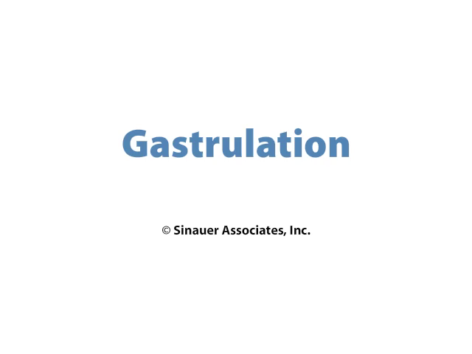
Xenopus Gastrulation

